Slide 1

Income Level Classification using census bureau database

Slide 2
Census Bureau Current Population Survey (CPS) Overview
The Current Population Survey (CPS) is the source of the official Government statistics on employment and unemployment. The CPS has been conducted monthly for over 50 years. Currently, CPS interviews about 54,000 households monthly, scientifically selected on the basis of area of residence to represent the nation as a whole, individual states, and other specified areas. Each household is interviewed once a month for four consecutive months one year, and again for the corresponding time period a year later. This technique enables CPS to obtain month-to-month and year-to-year comparisons at a reasonable cost while minimizing the inconvenience to any one household.
purpose of the survey: Although the main purpose of the survey is to collect information on the employment situation, a very important secondary purpose is to collect information on the demographic status of the population, information such as age, sex, race, marital status, educational attainment, and family structure.
From time-to-time additional questions are included on such important subjects as health, education, income, and previous work experience.
The statistics resulting from these questions serve to update similar information collected once every 10 years through the decennial census and are used by government policymakers and legislators as important indicators of our nations economic situation and for planning and evaluating many government programs.
The CPS provides current estimates of the economic status and activities of the population of the United States. Because it is not possible to develop one or two overall figures (such as the number of unemployed) that would adequately describe the labor market, the CPS is designed to provide a large amount of detailed and supplementary data. Such data are made available to meet a wide variety of needs on the part of users of labor market information.

Slide 3
CPS – Overview Continue
The CPS sample is based on the civilian noninstitutional population of the United States. The sample is in approximately 826 sample areas comprising 1,328 counties and independent cities with coverage in every State and in the District of Columbia. In all, some 70,000 housing units or other living quarters are assigned for interview each month; about 50,000 of them containing approximately 100,000 persons 15 years old and over are interviewed. CPS survey included demographic data for approximately 22,000 children 0- 14 years old and 400 Armed Forces members living with civilians either on or off base within these households.
The remainder of the assigned housing units are found to be vacant, converted to non-residential use, contain persons with residence elsewhere, or are not interviewed because the residents are not found at home after repeated calls, are temporarily absent, or are unavailable for other reasons.
Approximately 20,000 non-interview households are present each month. The resulting file size is approximately 142,000 records. Each year in the ASEC supplement, data are collected for armed forces members residing with their families in civilian housing units or on a military base. The armed forces members, however, are not asked the monthly labor force questions.
In addition, the ASEC is supplemented with a sample of Hispanic households identified the previous November. This results in the addition of about 6,000 households (4,500 interviewed). The inclusion of the additional sample of Hispanic households began in 1976.

Slide 4
Data Understanding
Data is collected in 2019 - Current Population Survey in Annual Social and Economic (ASEC) Supplement conducted by the Bureau of the Census for the Bureau of Labor Statistics in Washington USA.
The Dataset included the civilian noninstitutional population of the United States living in housing units and members of the Armed Forces living in civilian housing units on a military base or in a household not on a military base.
This Annual Social and Economic (ASEC) Supplement provides the usual monthly labor force data, but in addition, provides supplemental data on work experience, income, noncash benefits, and migration.
Survey covers all States, regions and divisions are identified in their entirety. Within confidentiality restrictions, indicators are provided for 260 selected core-based statistical areas (CBSA), 44 selected combined statistical areas (CSA), 280 counties, and 40 central cities in multi-central city core-based statistical areas or combined statistical areas. Also within confidentiality restrictions, indicators are provided for metropolitan/nonmetropolitan, central city/balance metropolitan, and CBSA size.

Slide 5
Project Overview
Client: United States Census Bureau
The client leads the countrys Federal Statistical System; its primary responsibility is to collect demographic and economic data about America to help inform strategic initiatives.
Objective: The main goal is to perform binary classification analysis to predict whether a person income level over 50K a year or not using census bureau database

Slide 6



Project Flow
Training Data
census_income_learn
census_income_learn_label
census_income_learn_ processed
Model Evaluation
Data Mapping
census_income_test_label
Testing Data
census_income_test
Data preprocessing
census_income_test_processed
Data Modeling
Save Best Model
Deploy Save Model

Slide 7
Data Collection
Sample Data
You have been provided a sample dataset from the US Census archive containing detailed, but anonymized, information for ~300,000 individuals. This archive contains four files:
1. census_income_learn.csv (data for model training).
2. census_income_test.csv (data for model testing).
3. census_income_metadata.txt (metadata for both datasets).
4. census_income_additional_info.pdf (supplemental information).

Slide 8
Data Mapping
Assigned data headers for training and testing dataset using column mappings of the Census Bureaus internal database. Which provided in census_income_metadata.txt file.

Slide 9
Data Acquisition
The learning data has 199523 number of instances in Learning and 99762 instances in test dataset with 42 number of features. Where 12 numeric and 29 categorical features.

Slide 10

Data Exploration

Slide 11
Data Exploration
Descriptive Analysis: perform Statistical Analysis for Numerical and Categorical Variables.
Univariate Analysis:
Plot histogram and Box plot is a representation of the distribution of dataset
Bivariate Analysis:
graphical representations of the data to explore relationship between independent and target variable.

Slide 12
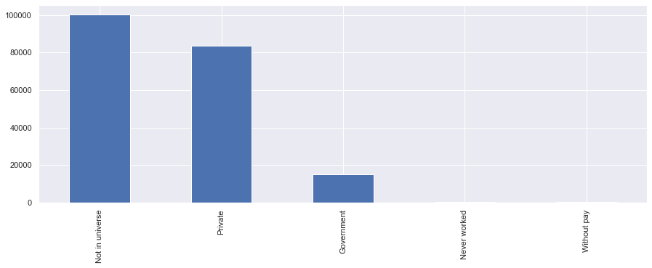
Compare Class of Worker who earn more than 50K

Slide 13
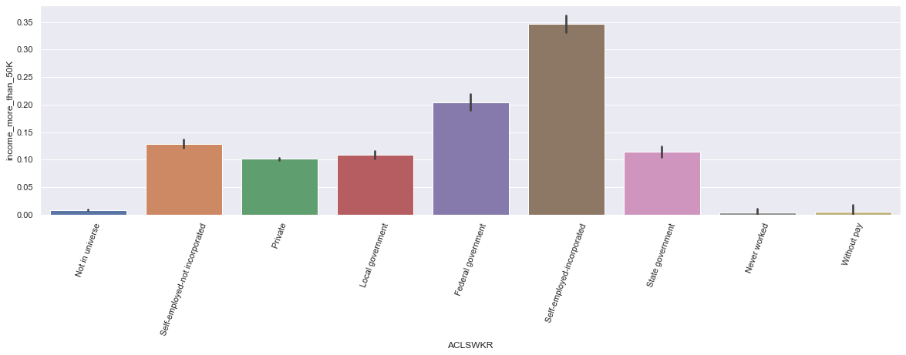

Slide 14
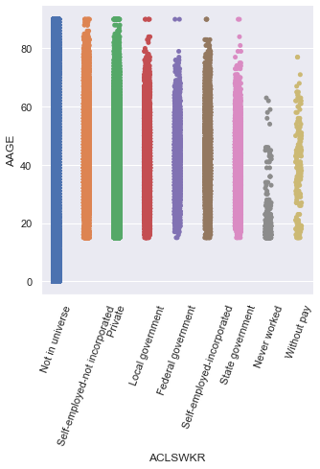
Minimum Age of Working

Slide 15
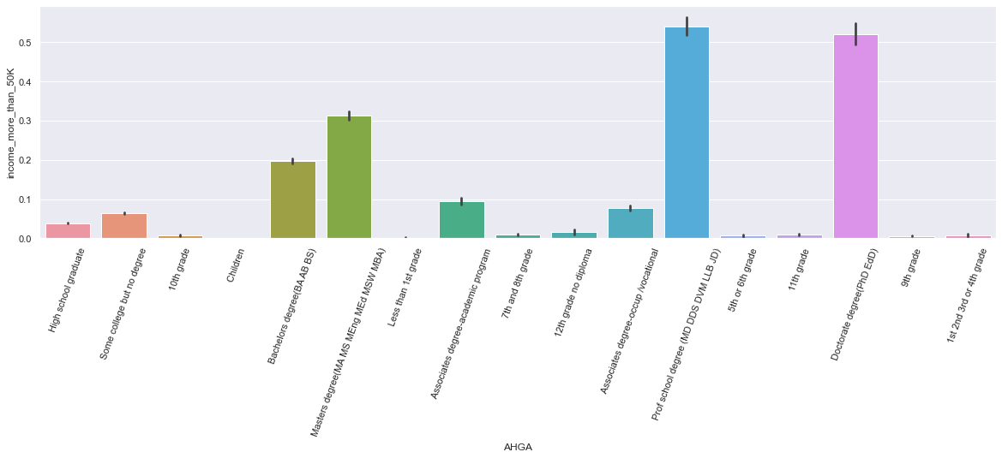
Impact of Education on Income Level

Slide 16
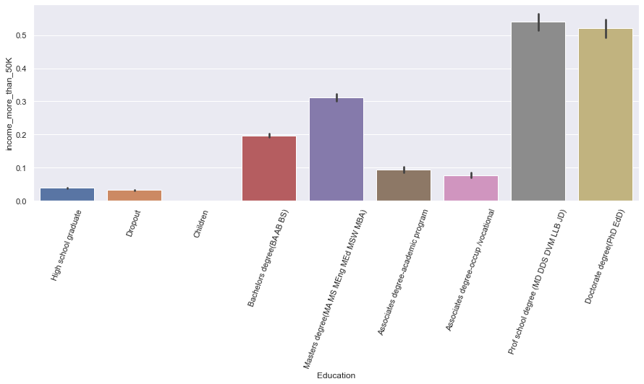

Slide 17
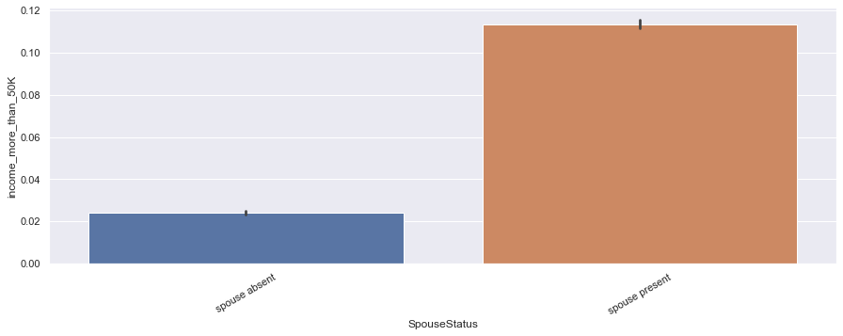
Impact of spouse in income level

Slide 18
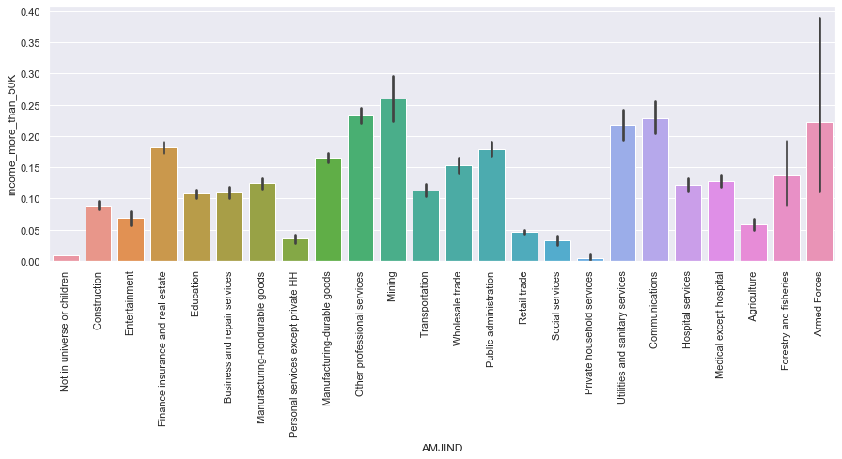
Industry Pays more income

Slide 19
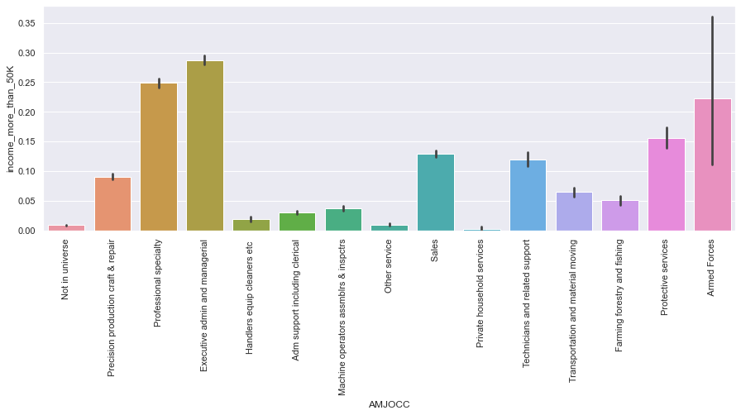
Occupation Earns more income

Slide 20
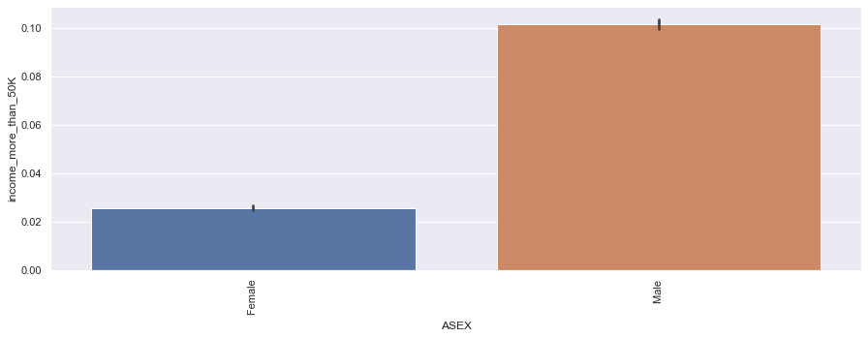
Gender impact on income level

Slide 21
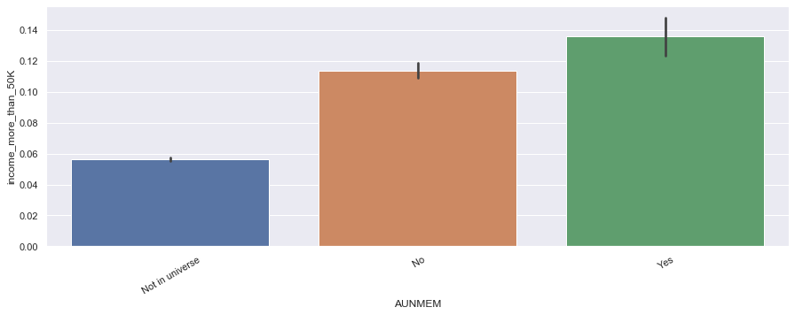
impact of membership of a labor union on income level

Slide 22
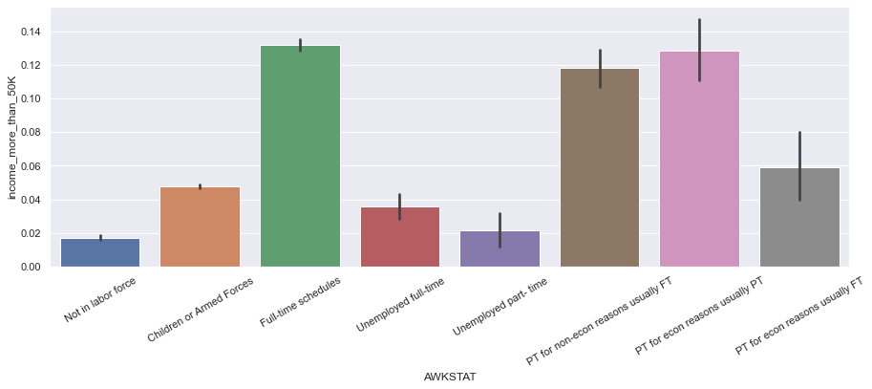
Impact of Job Type on income level

Slide 23
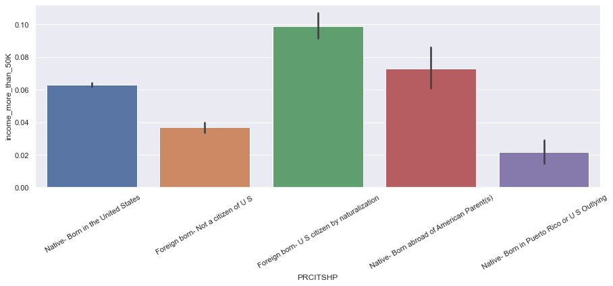
Citizenship impact on income level

Slide 24

Data Pre-processing

Slide 25
Data Cleaning
Plot histogram and Boxplot to data distribution representation and detect Outliers values in data
Find Duplicates and Missing records in data.
The learning data has 199523 number of instances in Learning and 99762 instances in test dataset with 42 number of features. whereas 3229 records in learning and 883 records in test dataset are duplicated and missing data. Therefore, drop duplicates records and replace NA and ? by Other. The Data has 12 numeric and 29 categorical features.
We detected Outliers in [AHRSPAY, CAPGAIN, CAPLOSS, DIVVAL, MARSUPWT, SEOTR] features. To handle outliers, we use Winsorize Method and make our upper and lower limits for data our new maximum and minimum points.

Slide 26

Feature Engineering

Slide 27
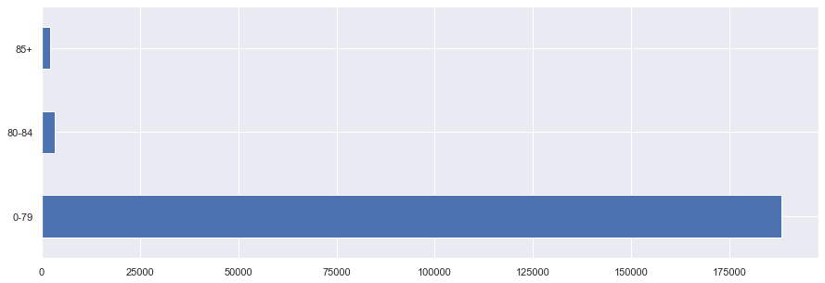
Age
Divide Person Age into Bins:
00-79 = 0-79 years of age
80 = 80-84 years of age
85-90 = 85+ years of age

Slide 28
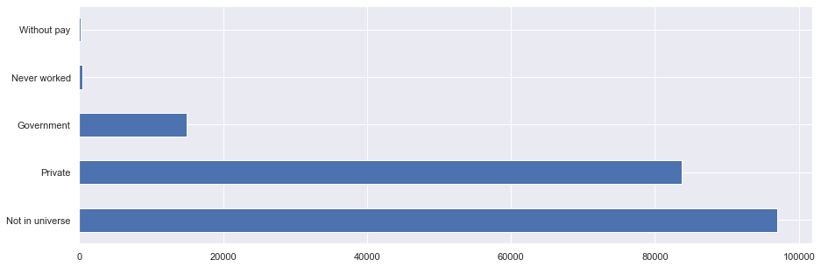
Worker Class
Self-employed-not incorporated – Private
Local government – Government
State government – Government
Self-employed-incorporated-Private
Federal government-Government

Slide 29
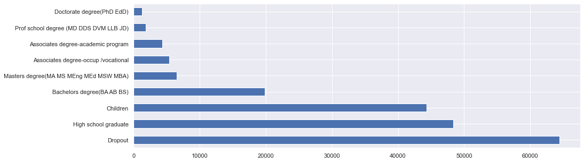
Education

Slide 30
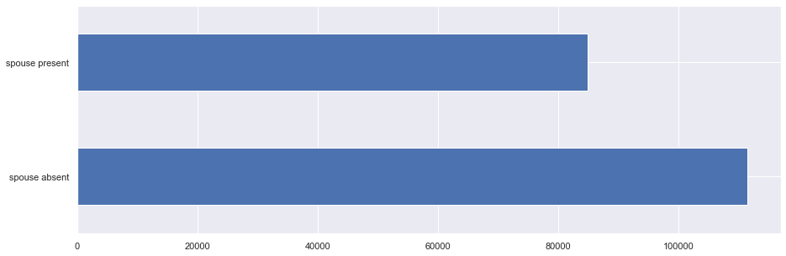
Spouse Status

Slide 31
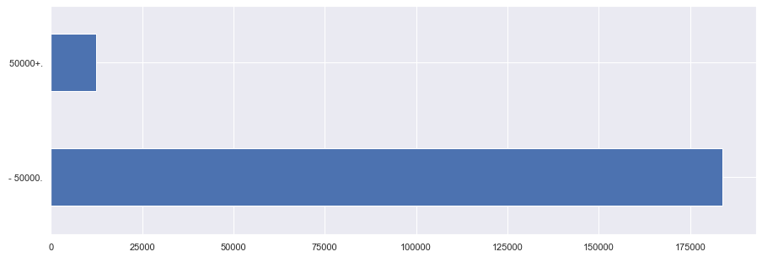
Define Target
Prediction Type: Binary Classification
Target Variable: income_level
Target classes
The data is imbalanced because 93.70% population having less than 50000, only 6.30% people earning more than 50000
Handle Data using Down sample method

Slide 32
Feature Handling
Data Encoding using label encoding method
Define Train and Test Dataset
Data Scaling using MinMaxScaler

Slide 33
Feature Selection
Feature Selection is effective in reducing the dimensionality, removing irrelevant and redundant feature.
Apply Lasso Regression for Feature Selection with
Best alpha 0.000125
Best score 0.486862
Selected 32 features AAGE, ACLSWKR, ADTIND, ADTOCC, AHGA, AHRSPAY, AHSCOL, AMARITL, AMJIND, AMJOCC, ARACE, AREORGN, ASEX, AUNMEM, AUNTYPE, AWKSTAT, FILESTAT, GRINREG, HHDFMX, HHDREL, MIGSAME, MIGSUN, NOEMP, PARENT, PRCITSHP, VETQVA, WKSWORK, year, Age, WorkerClass, Education, SpouseStatus

Slide 34

Data Modelling

Slide 35
Define Metric
Metric used to find the best model during hyperparameters optimization and K-Fold cross test Optimize model hyperparameters for ROC_AUC
Metric used to find the best threshold after building the model optimize threshold for F1 Score

Slide 36
Hyperparameters Optimization
Use GridSearchCV and explore following best parameters for models
Logistic Regression:
Best: 0.906407 using {'C': 3.727593720314938, 'penalty': 'l2', 'solver': 'lbfgs'}
K Neighbors Classifier:
Best: 0.907877 using {'metric': 'manhattan', 'n_neighbors': 19}
Random Forest Classifier:
Best: 0.911630 using {'max_features': 'log2', 'n_estimators': 15}
Gradient Boosting Classifier:
Best: 0.908137 using {'learning_rate': 0.1, 'n_estimators': 15}
XGBoost Classifier:
Best: 0.931716 using {'colsample_bytree': 0.3, 'gamma': 0.2, 'learning_rate': 0.1, 'max_depth': 5, 'min_child_weight': 1, 'subsample': 1.0}

Slide 37
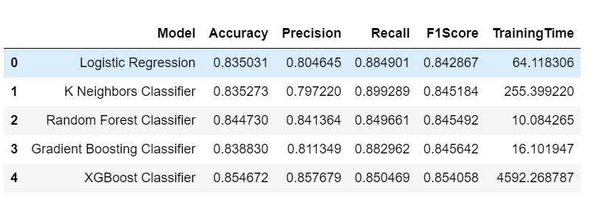
Model Performance Result

Slide 38
Model Assessment
The XGBoost Classifier Model F1_score 85.41% is high as compared to others.
Therefore, XGBoost Classifier Model is the best model based on performance comparisons.

Slide 39

Results

Slide 40
Summary of key findings
The dataset might be suffering from selection bias:
The 83.88% of data belong to White Race People, where only 16.13% of data collected from another race.
Many People in USA has 2 races as well. However, dataset included only one race.
The dataset is extracted in 2019 - Current Population Survey by ASEC Technical. The data is 4 years old. Therefore, some of the facts might not be applicable now.
Approximately 20,000 non-interview households are present each month. This could be the reason 83.33% of data belong to White Race.
AAGE: This variable defines "age of the Person". The Data has records for all person including who is not born or dead, Data included age range from 0 to 90. Where, 191237 people belong to 0-79 age group, 3214 people belong to 80-84 age group and 2233 has more than 85 age. Age data has right tail skewness (positive-skew distributions). And no outliers and No missing records detected in data.
ACLSWKR: The data contains 9 types of class of worker with nominal data. This refers to the broad classification of the person's employer. these broad classifications for current jobs are Not in universe, Self-employed-not incorporated, Private, Local government, Federal government, Self-employed-incorporated, State government, Never worked, Without pay. Where, 98827 data records almost 50% of data belong to people who is "not in universe" and not contribute to income level. Private and government workers has 98662 records and considered "wage and salary workers", which is 50% of the data. This includes private, Self-employed-not incorporated, Local government, State government, Self-employed-incorporated, Federal government, Without pay. On the other side, 165 workers only works without any pay and 438 people does not work. All Workers has more than 15 age expect "Not in universe". Therefore, Working minimum age is 15. The Highest Percentage of workers earns more than 50K belong to "Self-employed-incorporated". As compared to Government Jobs people prefer to the Private Jobs, Because people earns high pay in Private Jobs.
AHGA: people has 17 distinct education categories in data. which includes Level of School Completed/Degree Received by person. The highest level of education is "Doctorate degree(PhD EdD)" completed by 1263 people, which is second least achieved education. The most people completed High school graduation, which is 24% of the data with 48374 people. Educational attainment applies only to progress in "regular" school. Such schools include graded public, private, and parochial elementary and high schools (both junior and senior high), colleges, universities, and professional schools, whether day schools or night schools. Thus, regular schooling is that which may advance a person toward an elementary school certificate or high school diploma, or a college, university, or professional school degree. Schooling in other than regular schools is counted only if the credits obtained are regarded as transferable to a school in the regular school system. Whereas 12532 people enrolled in "High school" and "College or university". And 183762 people are enrolled in advance (non-born yet).More People earns more than 50K who has degree as compare the High school graduation or Dropout.

Slide 41
Summary of key findings
AMARITL: 7 distinct types of marital status people holds in data. The marital status classified in four major categories: single (never married), married, widowed, and divorced. The category "married" is further divided into "married, civilian spouse present," "married, Armed Forces spouse present," "married, spouse absent," "married, Armed Forces spouse absent," and "separated." A person is classified as "married, spouse present" if the husband or wife is reported as a member of the household even though he or she may be temporarily absent on business or on vacation, visiting, in a hospital, etc., at the time of the enumeration. Persons reported as "separated "included those with legal separations, those living apart with intentions of obtaining a divorce, and other persons permanently or temporarily estranged from their spouses because of marital discord. The almost 43% people has Married-civilian spouse present and almost same % of people are not married. Whereas 1517 people spouse are absent. As compared to Single Person More people earns 50K+ income if spouse is present.
AMJIND: Data includes 24 distinct major industry code to define primary industry. Where almost 50% people are not in universe or children. Mining industry has most employees who earns more than 50K and Private Household services pay rarely 50K+.
AMJOCC: Data includes 15 distinct major occupation code to define primary occupation. Where almost 50% people are not in universe. highest Percentage of workers earns more than 50K as an Executive admin and manager.
There is 5 types of race includes White, Black, Asian or Pacific Islander, Amer Indian Aleut or Eskimo and Other race. The last category includes any other race except the four mentioned. 84% of white people live in USA and only 1% population belong to "Amer Indian Aleut or Eskimo"
AREORGN: data has 10 different Hispanic Origin based on questionnaire. As compared to identified Origin, unidentified origin people is high, which is 86% of population, This includes All other, Do not Know, NA. The least Origin is Chicano.
The female population is high as compared to the male population. However, More male workers earn 50K+ income.
People who has "Foreign born- U S citizen by naturalization" increases chance to earn more than 50K.

Slide 42
Recommendation
Although we solved the problem successfully, we still have some extensions. For example, most variables in this dataset are categorical and some of them have many levels. I recommend to improve the performance of our models by using some suitable methods to reduce the number of levels for some categorical predictors before constructing predicted models.

Slide 43
Future Improvements
Apply PCA method. Whereas project uses lasso (L1 regularization) algorithm for "feature selection", which provides less scope of hyper parameter optimization. LASSO perform feature selection as the coefficients of predictors are shrunk towards zero. It still requires hyperparameter tuning because there is a regularization coefficient that weights how severe is the regularization of the loss function.
Some features are not normally distributed. We can handle this issue using neural network or Artificial Intelligence approaches and they might have a better prediction performance than the current models.
we only consider the relationship between income and the other covariates in this project. But the relationship between covariates might also be interesting, we can adopt graphical models to look into the dependence between predictors.

Slide 44
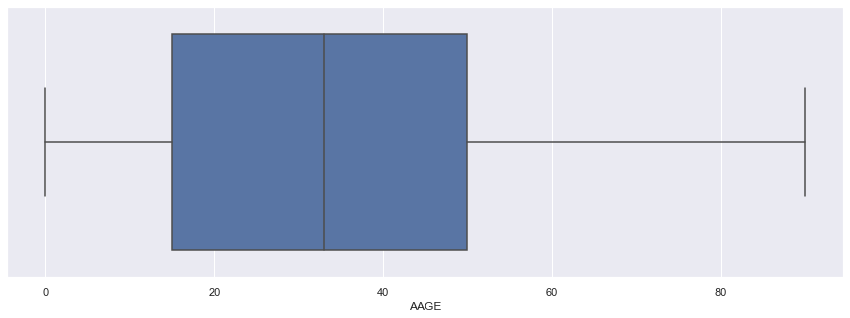
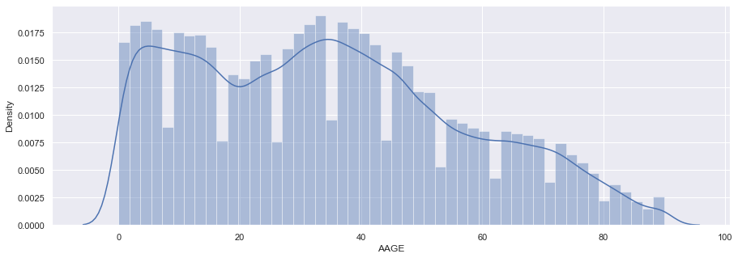
Age
Divide Person Age into Bins:
00-79 = 0-79 years of age
80 = 80-84 years of age
85-90 = 85+ years of age
Summary: This variable defines "age of the Person". The Data has records for all person including who is not born or dead, Data included age range from 0 to 90. Where, 191237 people belong to 0-79 age group, 3214 people belong to 80-84 age group and 2233 has more than 85 age. Age data has right tail skewness (positive-skew distributions). And no outliers and No missing records detected in data.

Slide 45
Thank You

